Slide 1
GraphX: Unifying Data-Parallel and Graph-Parallel Analytics
Presented by Joseph Gonzalez
Joint work with Reynold Xin, Daniel Crankshaw, Ankur Dave, Michael Franklin, and Ion Stoica
Strata 2014
*These slides are best viewed in PowerPoint with animation.

Slide 2
Graphs are Central to Analytics
Hyperlinks
PageRank
Top 20 Pages
Raw
Wikipedia
Text
Table
Title
PR
< / >
Title
Body
Term-Doc
Graph
Topic Model
(LDA)
< / >
< / >
Word Topics
XML
Word
Topic
Discussion
Table
Community
Detection
User
Community
Community
Topic
Editor Graph
User
Disc.
User
Com.
Topic
Com.

Slide 3
PageRank: Identifying Leaders
Rank of user i
Weighted sum of neighbors’ ranks
Update ranks in parallel
Iterate until convergence

Slide 4
The Graph-Parallel Pattern
Model / Alg.
State
Computation depends only on the neighbors

Slide 5
Many Graph-Parallel Algorithms
Collaborative Filtering
Alternating Least Squares
Stochastic Gradient Descent
Tensor Factorization
Structured Prediction
Loopy Belief Propagation
Max-Product Linear Programs
Gibbs Sampling
Semi-supervised ML
Graph SSL
CoEM
Community Detection
Triangle-Counting
K-core Decomposition
K-Truss
Graph Analytics
PageRank
Personalized PageRank
Shortest Path
Graph Coloring
Classification
Neural Networks

Slide 6


Graph-Parallel Systems
Pregel
oogle
Expose specialized APIs to simplify graph programming.
Exploit graph structure to achieve orders-of-magnitude performance gains over more general data-parallel systems.

Slide 7
PageRank on the Live-Journal Graph
GraphLab is 60x faster than Hadoop
GraphLab is 16x faster than Spark

Slide 8
Graphs are Central to Analytics
Hyperlinks
PageRank
Top 20 Pages
Raw
Wikipedia
Text
Table
Title
PR
< / >
Title
Body
Term-Doc
Graph
Topic Model
(LDA)
< / >
< / >
Word Topics
XML
Word
Topic
Discussion
Table
Community
Detection
User
Community
Community
Topic
Editor Graph
User
Disc.
User
Com.
Topic
Com.

Slide 9


Separate Systems to Support Each View
Table View
Graph View
Pregel
Table
Dependency Graph
Row
Row
Result
Row
Row
Notes:
----- Meeting Notes (1/5/14 14:58) -----
Spark too.

Slide 10
Having separate systems for each view is difficult to use and inefficient

Slide 11


Difficult to Program and Use
Users must Learn, Deploy, and Manage multiple systems
Leads to brittle and often complex interfaces

Slide 12
Inefficient
Extensive data movement and duplication across the network and file system
< / >
< / >
< / >
XML
HDFS
HDFS
HDFS
HDFS
Limited reuse internal data-structures across stages

Slide 13
Solution: The GraphX Unified Approach
New API
Blurs the distinction between Tables and Graphs
New System
Combines Data-Parallel Graph-Parallel Systems
Enabling users to easily and efficiently express the entire graph analytics pipeline

Slide 14
Tables and Graphs are composable views of the same physical data
GraphX Unified
Representation
Table View
Graph View
Each view has its own operators that exploit the semantics of the view
to achieve efficient execution
Notes:
and users can move between views without copying or moving data

Slide 15
View a Graph as a Table
Vertex Property Table
Property Graph
Id
Rxin
Jegonzal
Franklin
Istoica
Property (V)
(Stu., Berk.)
(PstDoc, Berk.)
(Prof., Berk)
(Prof., Berk)
R
F
Edge Property Table
SrcId | DstId
rxin | jegonzal
franklin | rxin
istoica | franklin
franklin | jegonzal
Property (E)
Friend
Advisor
Coworker
PI
J
I

Slide 16
Table Operators
Table (RDD) operators are inherited from Spark:
map
filter
groupBy
sort
union
join
leftOuterJoin
rightOuterJoin
reduce
count
fold
reduceByKey
groupByKey
cogroup
cross
zip
sample
take
first
partitionBy
mapWith
pipe
save
...

Slide 17
Graph Operators
class Graph [ V, E ] {
def Graph(vertices: Table[ (Id, V) ],
edges: Table[ (Id, Id, E) ])
// Table Views -----------------
def vertices: Table[ (Id, V) ]
def edges: Table[ (Id, Id, E) ]
def triplets: Table [ ((Id, V), (Id, V), E) ]
// Transformations ------------------------------
def reverse: Graph[V, E]
def subgraph(pV: (Id, V) => Boolean,
pE: Edge[V,E] => Boolean): Graph[V,E]
def mapV(m: (Id, V) => T ): Graph[T,E]
def mapE(m: Edge[V,E] => T ): Graph[V,T]
// Joins ----------------------------------------
def joinV(tbl: Table [(Id, T)]): Graph[(V, T), E ]
def joinE(tbl: Table [(Id, Id, T)]): Graph[V, (E, T)]
// Computation ----------------------------------
def mrTriplets(mapF: (Edge[V,E]) => List[(Id, T)], reduceF: (T, T) => T): Graph[T, E]
}
Notes:
Make mrTriplets more visible.

Slide 18
Triplets Join Vertices and Edges
The triplets operator joins vertices and edges:
Vertices
Triplets
Edges
A
A
A
A
B
B
B
B
A
C
A
C
C
B
C
B
C
D
C
D
C
D
The mrTriplets operator sums adjacent triplets.
SELECT t.dstId, reduceUDF( mapUDF(t) ) AS sum
FROM triplets AS t GROUPBY t.dstId
Notes:
w

Slide 19
Map Reduce Triplets
Map-Reduce for each vertex
B
C
mapF( )
A₁
A
B
A
mapF( )
A₂
A
C
D
E
reduceF( , )
A
A₁
A₂
F

Slide 20
Example: Oldest Follower
23
42
B
C
What is the age of the oldest follower for each user?
val oldestFollowerAge = graph .mrTriplets( e=> (e.dst.id, e.src.age),//Map (a,b)=> max(a, b) //Reduce ) .vertices
30
A
D
19
E
75
F
16

Slide 21
We express the Pregel and GraphLab abstractions using the GraphX operators in less than 50 lines of code!
By composing these operators we can construct entire graph-analytics pipelines.

Slide 22
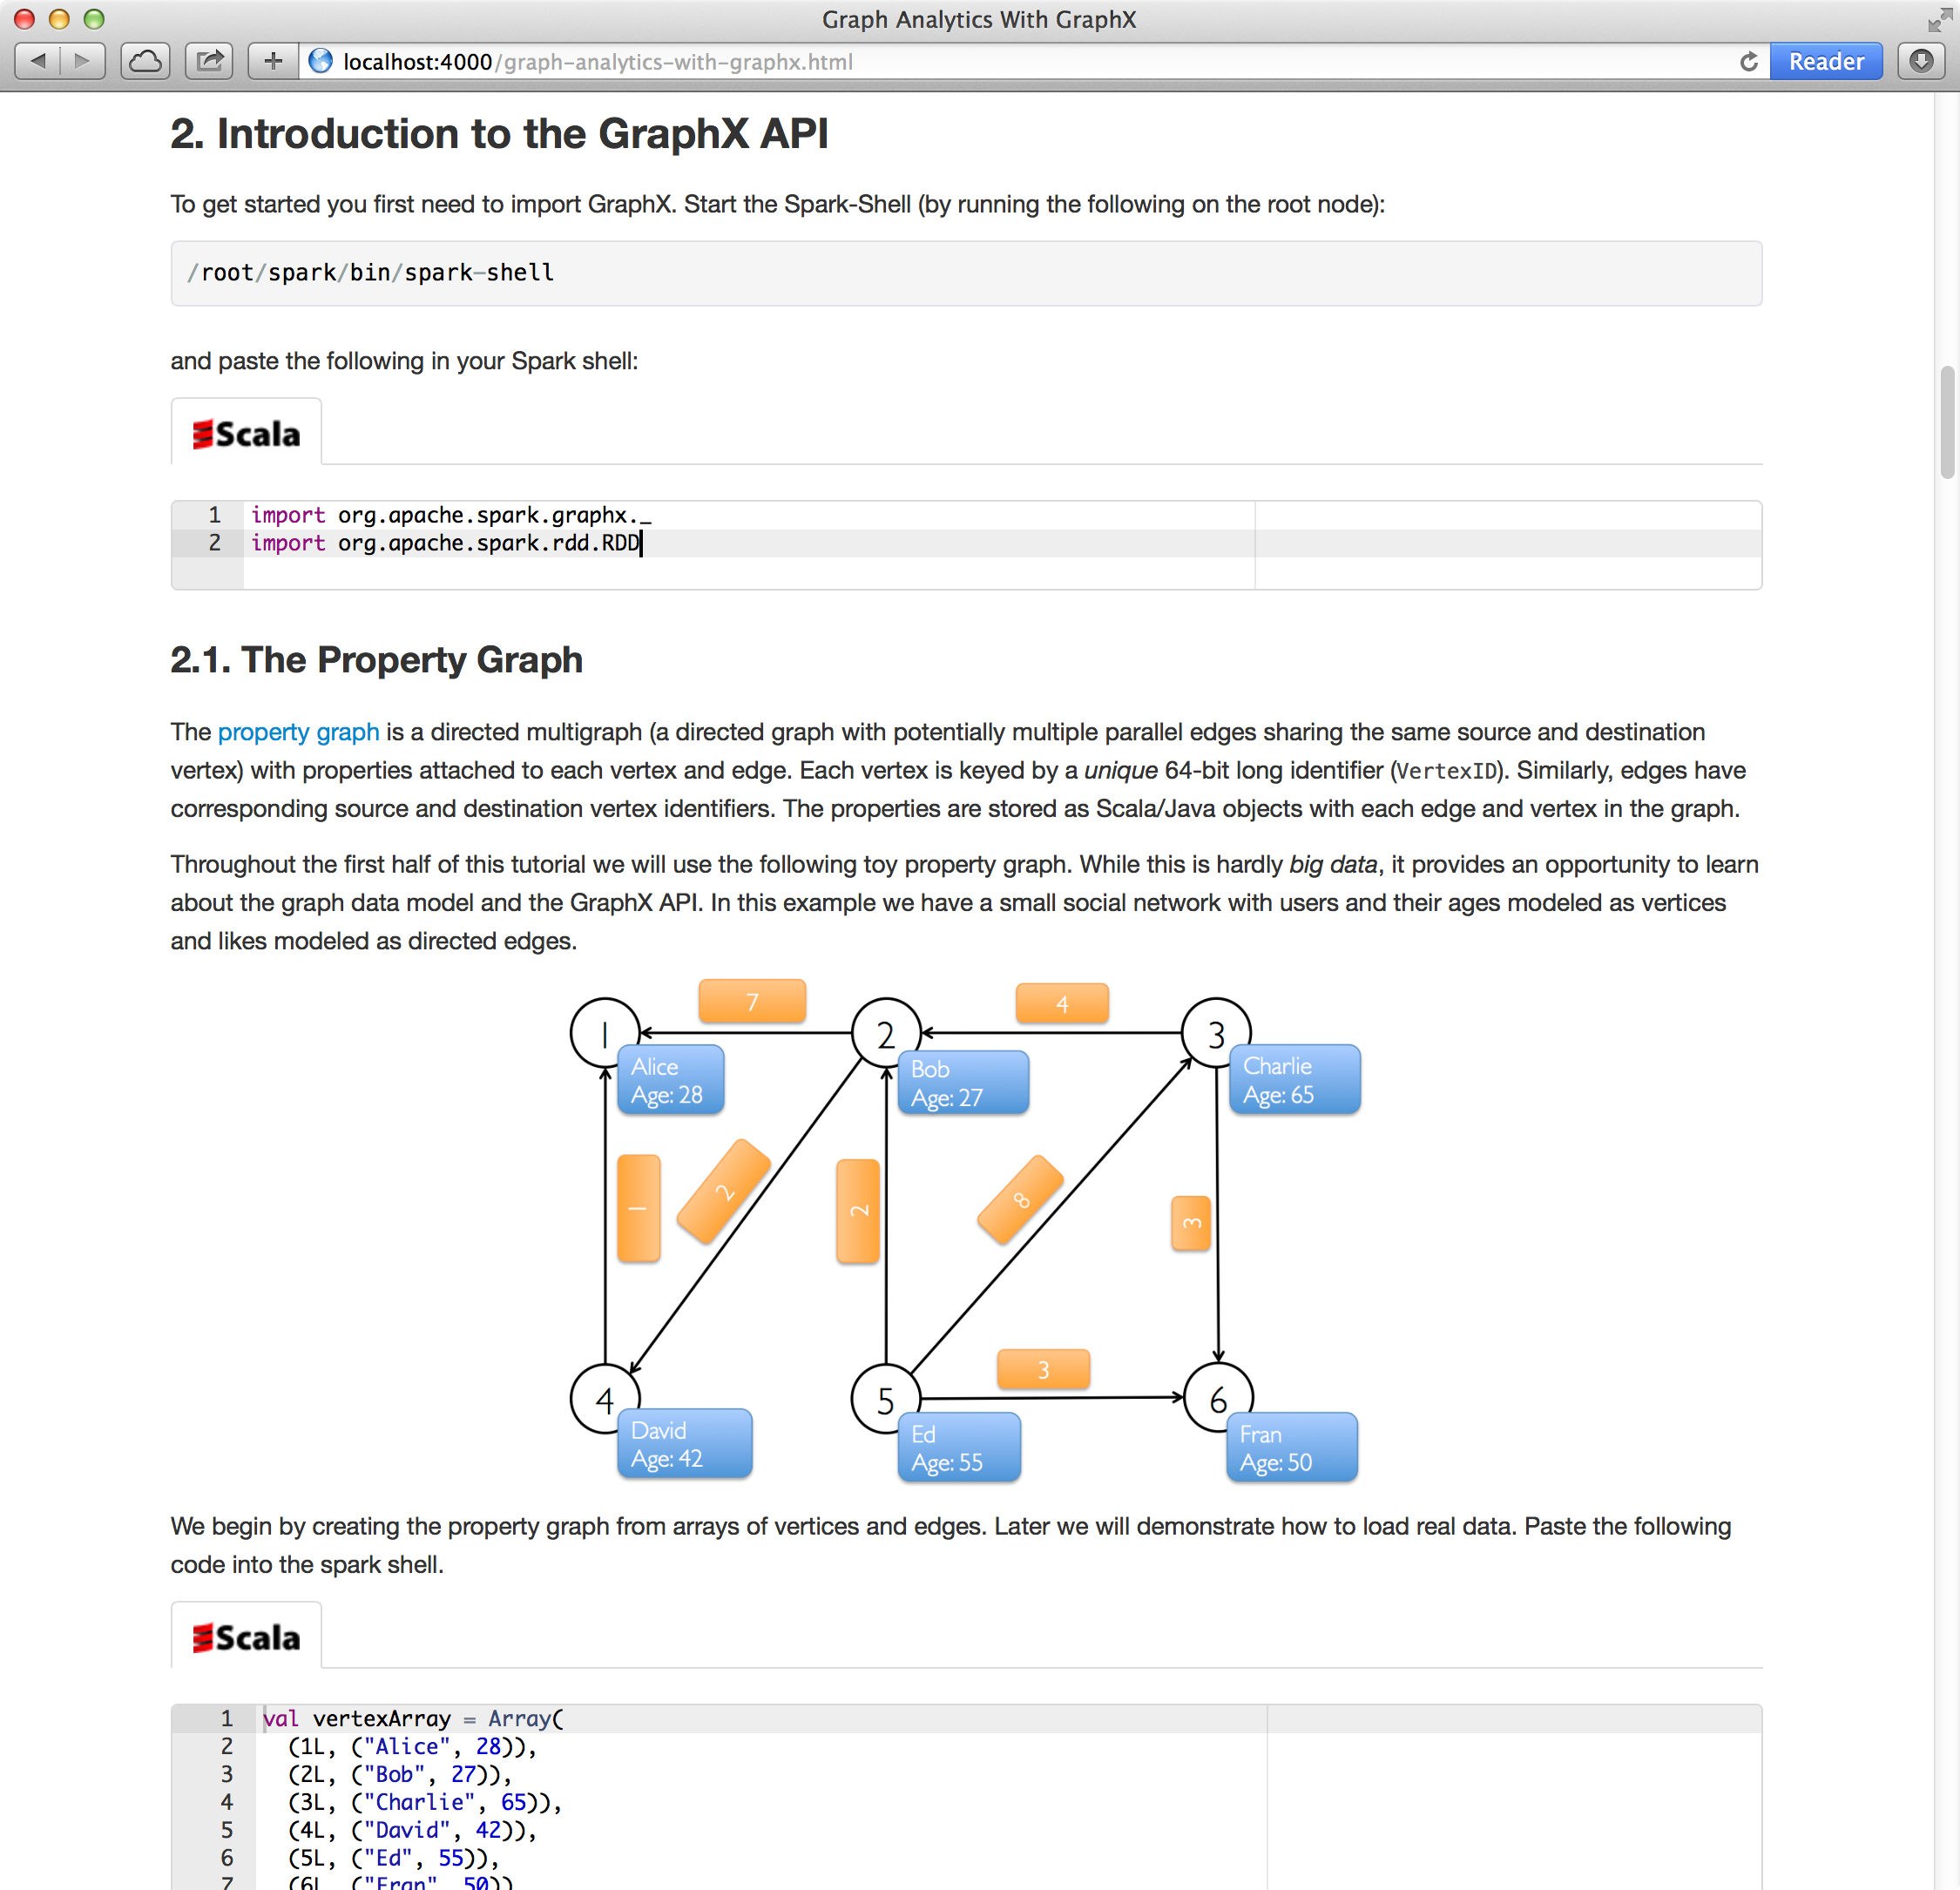
DIY Demo this Afternoon

Slide 23
GraphX System Design

Slide 24
Distributed Graphs as Tables (RDDs)
Vertex Table (RDD)
Routing
Table (RDD)
Edge Table
(RDD)
Property Graph
Part. 1
A
B
B
A
A
1
2
B
C
C
A
C
B
B
1
B
C
C
D
A
A
A
D
D
D
C
C
1
2D Vertex Cut Heuristic
A
D
Part. 2
A
E
D
D
1
2
A
F
F
F
E
E
E
E
2
E
D
F
F
2
E
F

Slide 25
Caching for Iterative mrTriplets
Vertex Table (RDD)
Edge Table
(RDD)
Mirror
Cache
A
B
A
A
A
A
A
C
B
B
B
B
C
C
D
C
D
C
C
Mirror
Cache
A
E
D
D
D
A
A
F
E
D
E
E
D
E
F
F
F
E
F

Slide 26
Incremental Updates for Iterative mrTriplets
Vertex Table (RDD)
Edge Table
(RDD)
Mirror
Cache
A
B
Change
A
A
A
A
A
C
B
B
B
C
C
D
C
D
C
Mirror
Cache
A
E
D
A
A
F
D
Change
E
Scan
E
E
D
E
F
F
E
F

Slide 27
Aggregation for Iterative mrTriplets
Vertex Table (RDD)
Edge Table
(RDD)
Mirror
Cache
A
B
Change
A
A
A
C
Local
Aggregate
B
B
Change
B
B
C
C
C
D
C
D
Change
C
Mirror
Cache
A
E
Change
D
A
A
F
Local
Aggregate
D
E
Scan
Change
D
E
D
E
Change
F
F
F
E
F

Slide 28
Reduction in Communication Due to Cached Updates
Most vertices are within 8 hops of all vertices in their comp.

Slide 29
Benefit of Indexing Active Edges
Scan All Edges
Index of “Active” Edges

Slide 30
Join Elimination
Identify and bypass joins for unused triplets fields
Example: PageRank only accesses source attribute
Factor of 2 reduction in communication

Slide 31
Additional Query Optimizations
Indexing and Bitmaps:
To accelerate joins across graphs
To efficiently construct sub-graphs
Substantial Index and Data Reuse:
Reuse routing tables across graphs and sub-graphs
Reuse edge adjacency information and indices
Notes:
Split Hash Table: reuse key sets across hash tables

Slide 32
Performance Comparisons
Live-Journal: 69 Million Edges
GraphX is roughly 3x slower than GraphLab

Slide 33
GraphX scales to larger graphs
Twitter Graph: 1.5 Billion Edges
GraphX is roughly 2x slower than GraphLab
Scala + Java overhead: Lambdas, GC time, …
No shared memory parallelism: 2x increase in comm.

Slide 34
PageRank is just one stage…. What about a pipeline?

Slide 35
A Small Pipeline in GraphX
Raw Wikipedia
Hyperlinks
PageRank
Top 20 Pages
< / >
< / >
< / >
HDFS
HDFS
XML
Spark Preprocess
Compute
Spark Post.
605
375
Timed end-to-end GraphX is faster than GraphLab
Notes:
Also faster in human time but it is hard to measure.

Slide 36
The GraphX Stack (Lines of Code)
PageRank (5)
Connected Comp. (10)
Shortest Path (10)
SVD
(40)
ALS
(40)
K-core
(51)
Triangle
Count
(45)
LDA
(120)
Pregel (28) + GraphLab (50)
GraphX (3575)
Spark

Slide 37
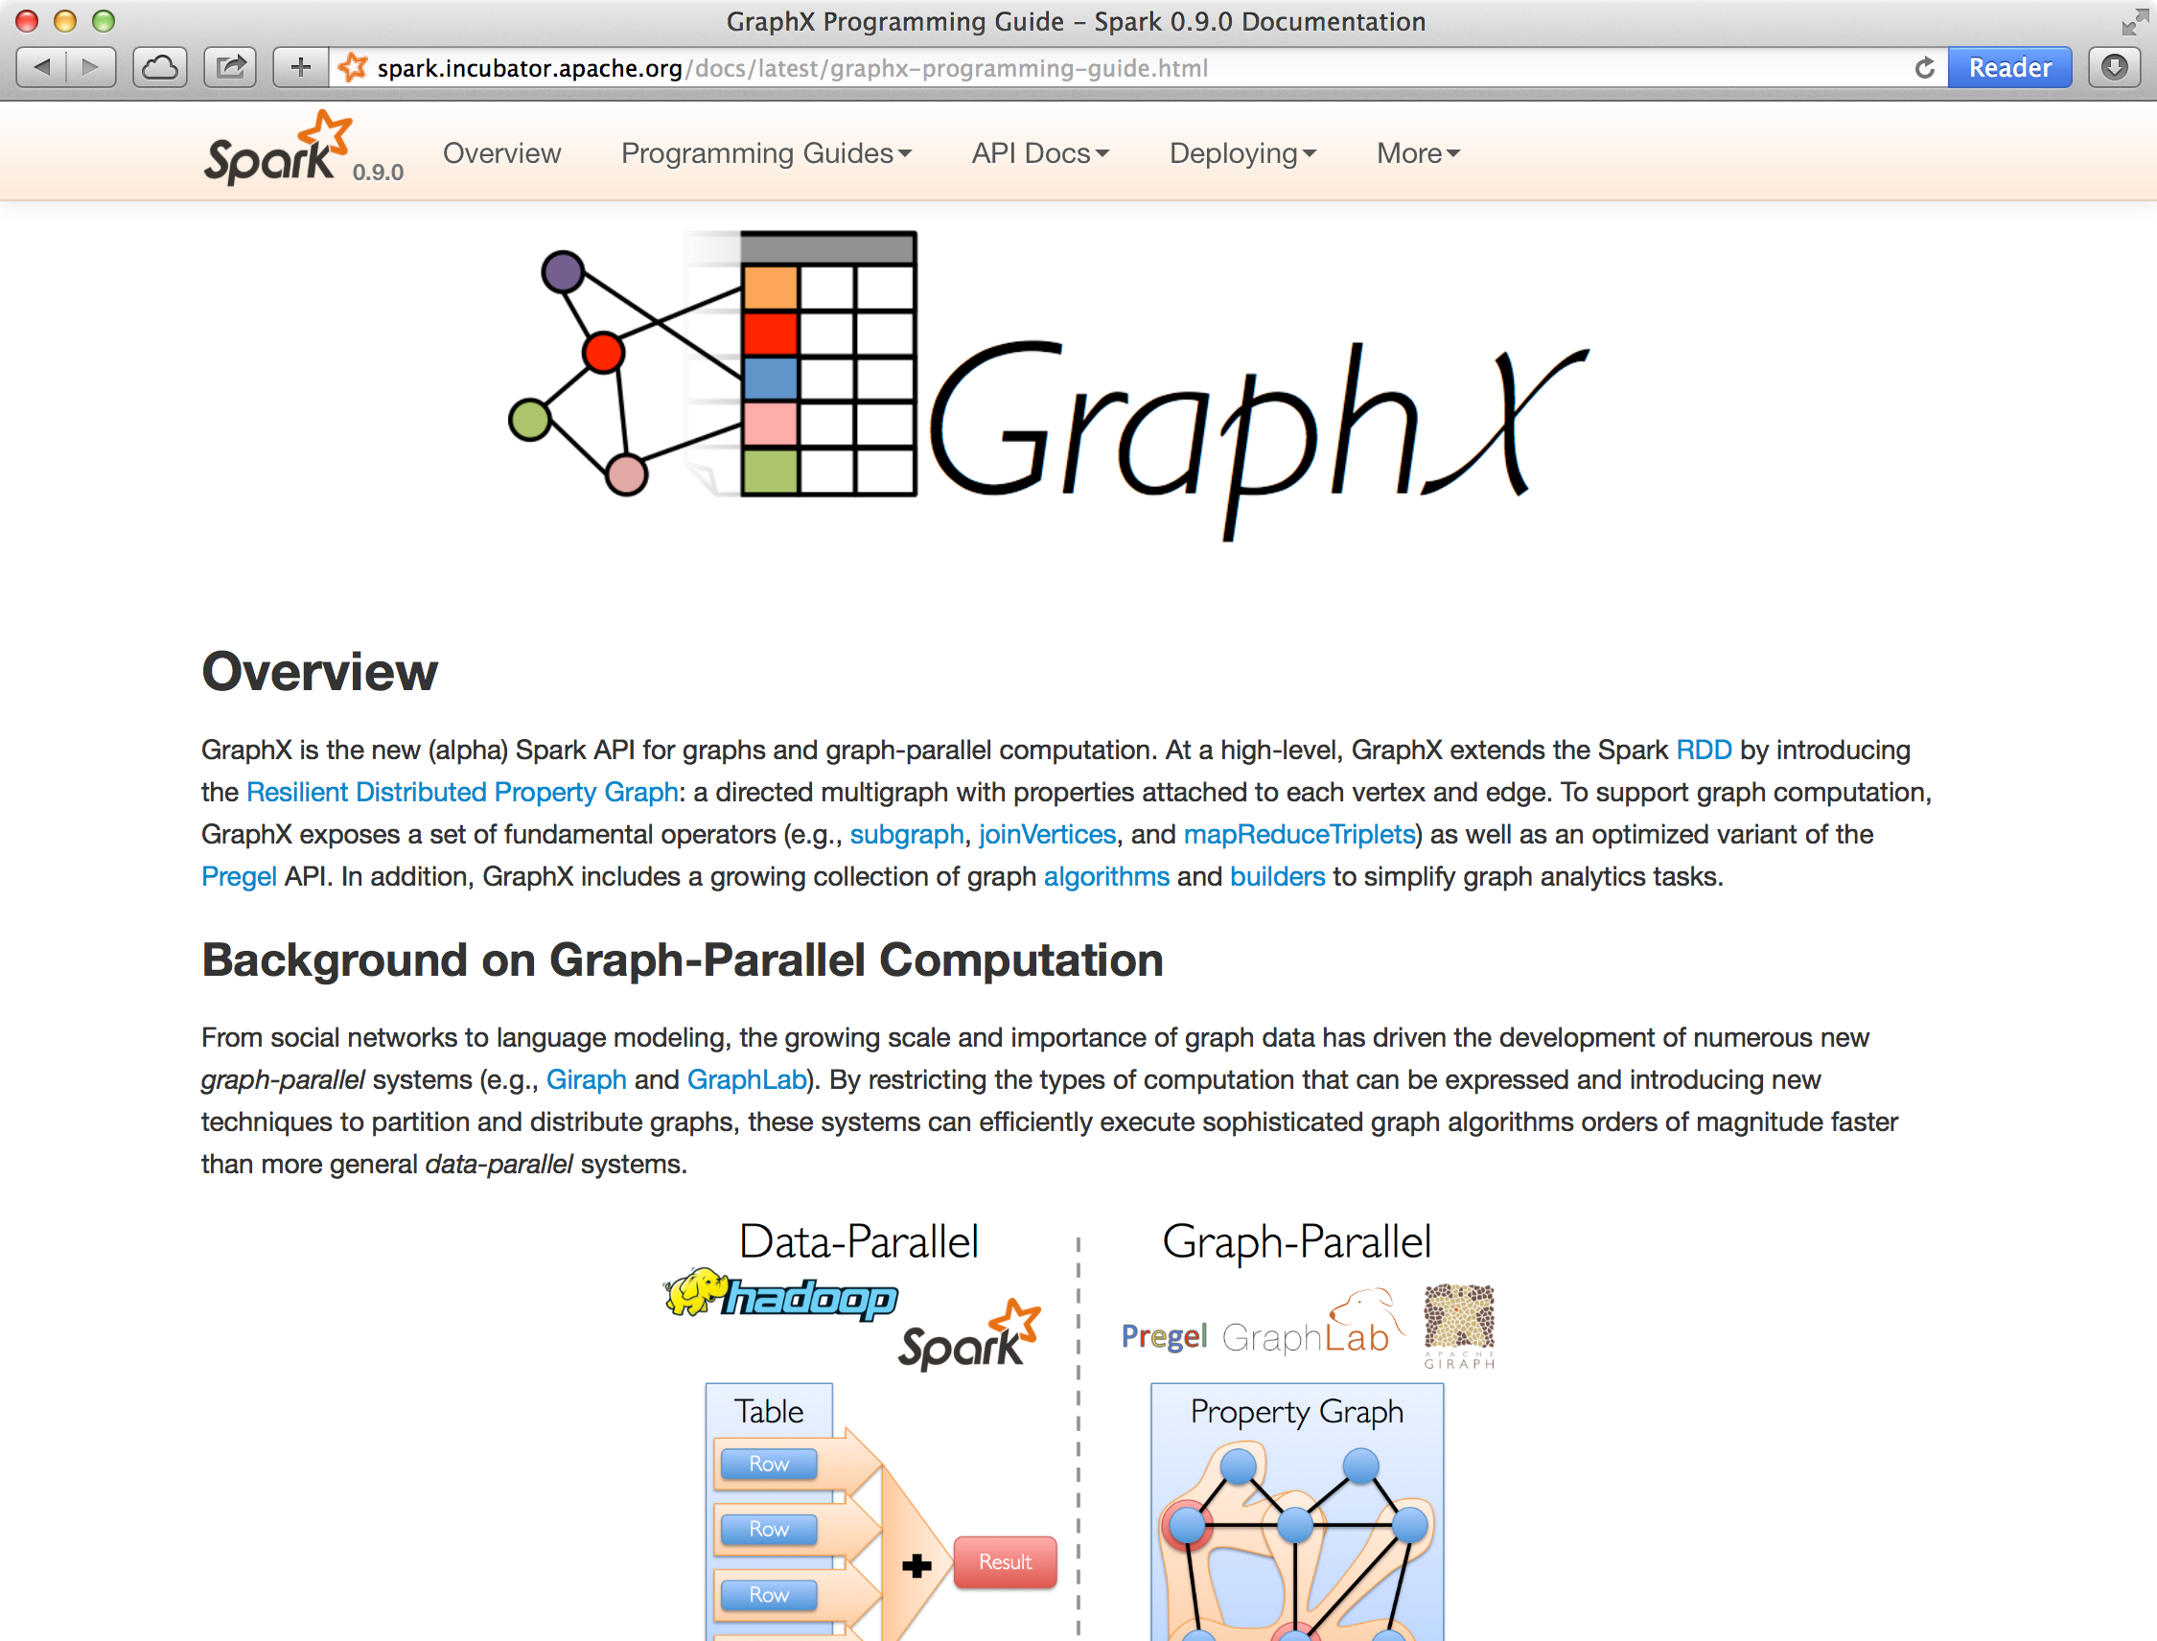
Status
Alpha release as part of Spark 0.9
Seeking collaborators and feedback

Slide 38
Conclusion and Observations
Domain specific views: Tables and Graphs
tables and graphs are first-class composable objects
specialized operators which exploit view semantics
Single system that efficiently spans the pipeline
minimize data movement and duplication
eliminates need to learn and manage multiple systems
Graphs through the lens of database systems
Graph-Parallel Pattern → Triplet joins in relational alg.
Graph Systems → Distributed join optimizations

Slide 39
Active Research
Static Data → Dynamic Data
Apply GraphX unified approach to time evolving data
Model and analyze relationships over time
Serving Graph Structured Data
Allow external systems to interact with GraphX
Unify distributed graph databases with relational database technology

Slide 40
Thanks!
http://amplab.github.io/graphx/
ankurd@eecs.berkeley.edu
crankshaw@eecs.berkeley.edu
rxin@eecs.berkeley.edu
jegonzal@eecs.berkeley.edu

Slide 41
Graph Property 1 Real-World Graphs
Power-Law Degree Distribution
Edges >> Vertices
AltaVista WebGraph1.4B Vertices, 6.6B Edges
More than 10⁸ vertices have one neighbor.
Top 1% of vertices are adjacent to
50% of the edges!
-Slope = α ≈ 2
Number of Vertices
Degree

Slide 42
Graph Property 2 Active Vertices
PageRank on Web Graph
51% updated only once!

Slide 43
Graphs are Essential to Data Mining and Machine Learning
Identify influential people and information
Find communities
Understand people’s shared interests
Model complex data dependencies

Slide 44










Recommending Products
Users
Ratings
Items

Slide 45
Recommending Products
Low-Rank Matrix Factorization:
f(3)
r₁₃
Movies
f(1)
Netflix
≈
x
Users
Users
f(j)
r₁₄
f(4)
f(i)
User Factors (U)
Movie Factors (M)
r₂₄
f(2)
Movies
r₂₅
f(5)
Iterate:

Slide 46



Predicting User Behavior
?
?
Liberal
Conservative
?
?
?
?
?
?
?
?
Post
?
Post
?
Post
Post
?
Post
Post
Post
Post
?
Post
Post
Post
Post
?
Post
?
Post
?
?
?
?
?
Post
?
Post
Post
Post
Conditional Random Field
Belief Propagation
Post
Post
Post
?
Post
?
?
?
?
?
?
?

Slide 47
Finding Communities
Count triangles passing through each vertex:
Measures “cohesiveness” of local community
2
3
1
4
Fewer Triangles
Weaker Community
More Triangles
Stronger Community

Slide 48
Example Graph Analytics Pipeline
Preprocessing
Compute
Post Proc.
< / >
< / >
< / >
XML
Raw
Data
ETL
Slice
Compute
Analyze
Initial
Graph
Subgraph
PageRank
Top
Users
Repeat

